Slide 1
Using D-Book and Interactive Board in Teaching English
Vo Tan Dung

Slide 2
Content
SEAMEO RETRAC’s e-Material
Advantages and challenges of developing English teaching e-materials using Powerpoint
Development of English teaching materials by using Dbook

Slide 3
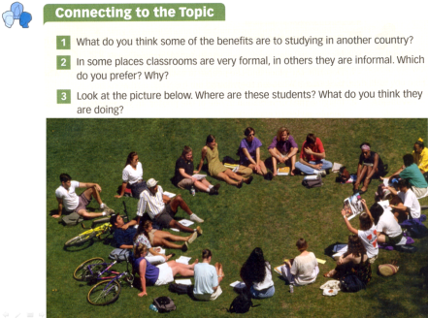
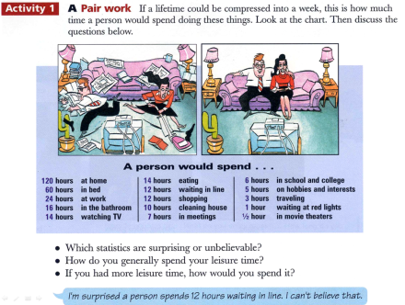
SEAMEO RETRAC e-Material
Pilot Phase (August 2003 – May 2005): Powerpoint

Slide 4
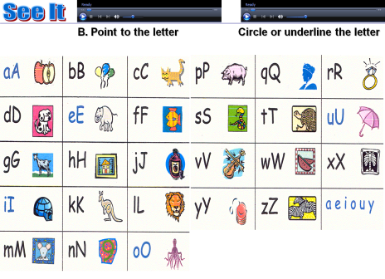
SEAMEO RETRAC e-Material
Phase 1 (Jun 2005 – Dec 2007): Powerpoint with multimedia

Slide 5
SEAMEO RETRAC e-Material
Phase 2 (Jan 2008 – Dec 2010): Flash with audio, video

Slide 6
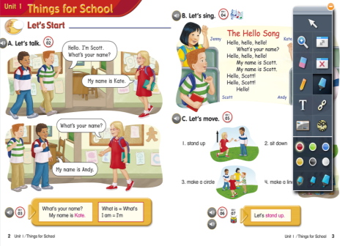
SEAMEO RETRAC e-Material
Phase 3 (Jan 2011 – Present): iTools

Slide 7
Powerpoint
Advantages
Popular and known by the majority of teachers
Easy to use
Animated
Easy to insert pictures, audio, video, flash
Challenges
Take times to design
Some materials (e.g. reading section with many pages…) cannot be formatted with Powerpoint

Slide 8
Trends
Most materials currently come with CD of e-lessons, teachers can make use of this without using PowerPoint
This kind of e-materials has the same interface as books, teachers can maximize or minimize, and note on the screen while teaching
Advantage: Flexible
Example:

Slide 9
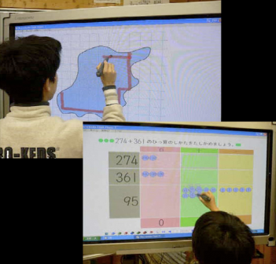
Dbook
Introduction of Dbook
Copyright: University of Tsukuba, Japan
Download: http://tinyurl.com/3ph9xlw

Slide 10
Dbook
Dbook will help transfer regular books into e-materials
Steps to develop materials by using Dbook
Step 1: Scan materials
Step 2: Unit division and numbering pages starting from 0
Step 3: Using Dbook to make e-materials
Step 4: Using RETRAC’s template to insert Audio

Slide 11
DEMO

Slide 12
Combination of Dbook and ISB

Slide 13
Conclusion
Books can be transferred into e-materials with Dbook
Flexible to use in teaching
Can be easily integrated into the ISB

